Slide 1
ReportDiff: Analysis and Feedback for Resident Dictated Reports
Phillip Cheng, MD MS
Miriam Romero, MD
M. Victoria Marx, MD

Slide 2
Objective
The purpose of this exhibit is to illustrate an open source system for displaying attending edits of trainee dictated reports, providing both feedback to residents and report editing statistics for educators.
Patient and study identifiers shown in this presentation
have been obscured, altered or synthesized.

Slide 3
Radiology Reporting Education
Communication skills constitute one of the ACGME residency core competencies.
Evaluated in the radiology milestone group “Effective communication with members of the healthcare team”
The radiology report is the primary communication “product” of a working radiologist.
However, reporting skills are typically taught informally, with evaluation in the form of general comments based on attending recollections or arbitrary sampling.

Slide 4
Preliminary Dictation Workflow
At our teaching institution, radiology trainees review studies with an attending, and dictate preliminary reports.
Attending physicians later edit and finalize the trainee reports.
Resident
Preliminary reports
Attending
Report editing
Finalized reports

Slide 5
A Feedback Problem
Preliminary reports ≠ Final reports
Attendings may perform a wide variety of editing tasks on preliminary reports, correcting content, spelling, grammar, style, and organization.
These edits are not typically performed in the presence of the trainee, and represent a “lost” educational opportunity.

Slide 6
Feedback for resident reports
ReportDiff is a lightweight open source system that completes the report editing communication loop between attendings and residents.
ReportDiff
Resident
?
Finalized reports
Preliminary reports
Edits
Attending

Slide 7
ReportDiff Components
ReportDiff consists of
A retrieval script which gathers preliminary and final radiology reports from the dictation system;
A web service that allows viewing of report edits;
An analytics script which produces statistics and graphs
ReportDiff
Retriever
(Python)
ReportDiff
Server
(Python - Flask)
ReportDiff
Analytics
(R)

Slide 8
ReportDiff
Retriever
(Python, C#)
Database
Preliminary
Reports
Final
Reports
ReportDiff
Analytics
ReportDiff
Server (Python Flask)
ReportDiff System Components

Slide 9
Report Data Sources
Our site’s RIS lacks programmatic data access, and does not permanently store preliminary reports.
Extracted reports from our PACS server contain modifications for printing, creating problems for text analysis.
Fortunately, our reporting system (Powerscribe 360) features a web API allowing automated retrieval of both preliminary and final reports.

Slide 10
ReportDiff Retriever
The retrieval script periodically queries our dictation system for preliminary reports and caches them, since the dictation system (like the RIS and PACS) does not permanently store the preliminary reports.
ReportDiff
Retriever
(Python)
ReportDiff
Server
(Python - Flask)
ReportDiff
Analytics
(R)

Slide 11
ReportDiff
Retriever
(Python)
1
2
Database
Preliminary
Reports
Final
Reports
Every 5 minutes: retrieve trainee-signed preliminary reports from the Powerscribe 360 server.
Query PS360 server for final versions for cached prelim reports.
Compute edit distance between prelim and final reports.

Slide 12
Edit Distance
Measure of how different two text strings (i.e. preliminary and final reports) are to each other; also known as diff score, Levenshtein distance
Number of editing operations needed to transform one string into another
Insertion
Deletion
Substitution
Notes:
String similarity used for spell correction, computational biology, machine translation, information extraction, speech recognition

Slide 13
Examples of Edit Distance
Original:
Final:
Edit score: 4
4 characters added
Original:
Final:
Edit score: 5
3 chars substituted
2 chars deleted

Slide 14
Edit Score Percent
Many edits in a long report may reflect a degree of editing similar to a few edits in a very short report.
We use an edit score percent (Levenshtein Percent) to adjust edit scores for the length of report, by dividing the edit distance by the character length of the report.
Surrey D, Sharpe RE, Gorniak RJT et al. J Digit Imaging 2013; 26: 678-682.

Slide 15
ReportDiff Server
A simple cross-platform web server allows trainees to review attending edits of their reports.
Uses the Flask microframework for Python (http://flask.pocoo.org).
ReportDiff
Retriever
(Python)
ReportDiff
Server
(Python - Flask)
ReportDiff
Analytics
(R)

Slide 16
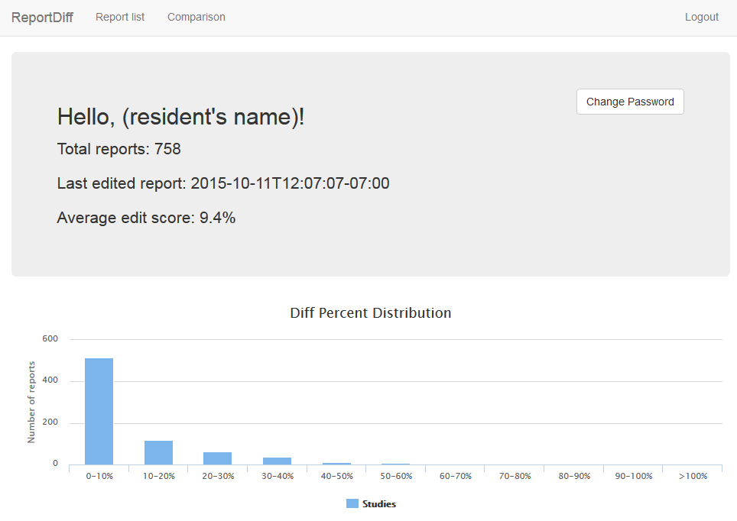
Login screen provides aggregate report editing statistics

Slide 17
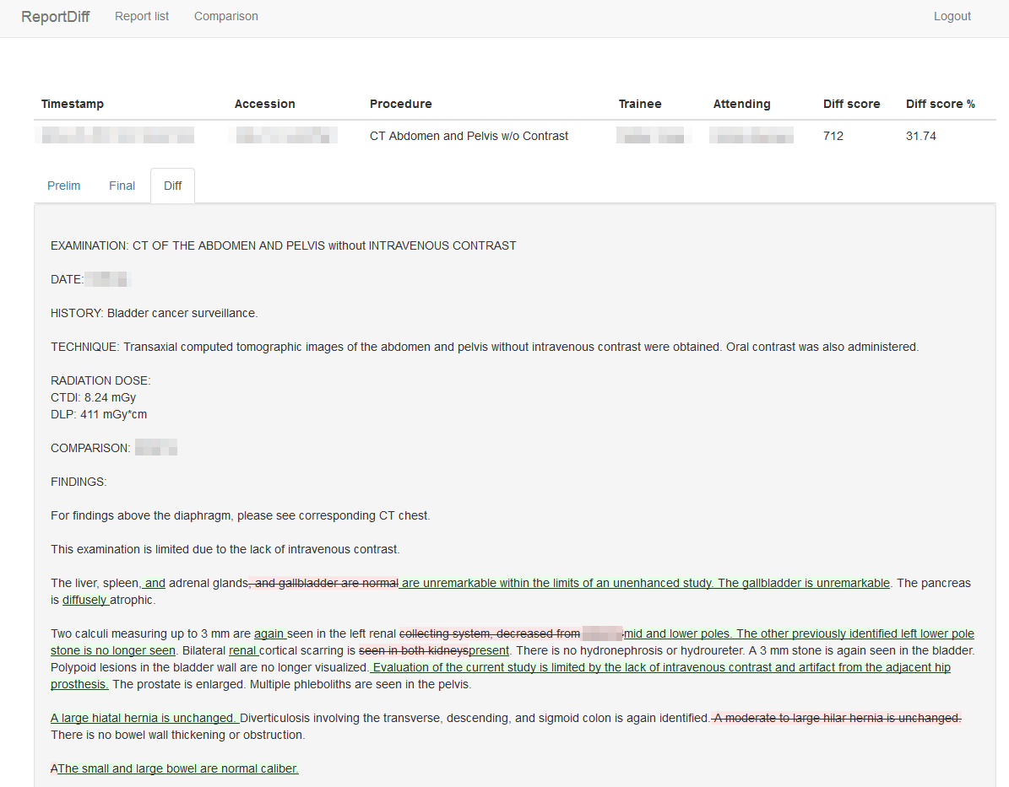
Report edits (additions in green, deletions in red) are highlighted

Slide 18
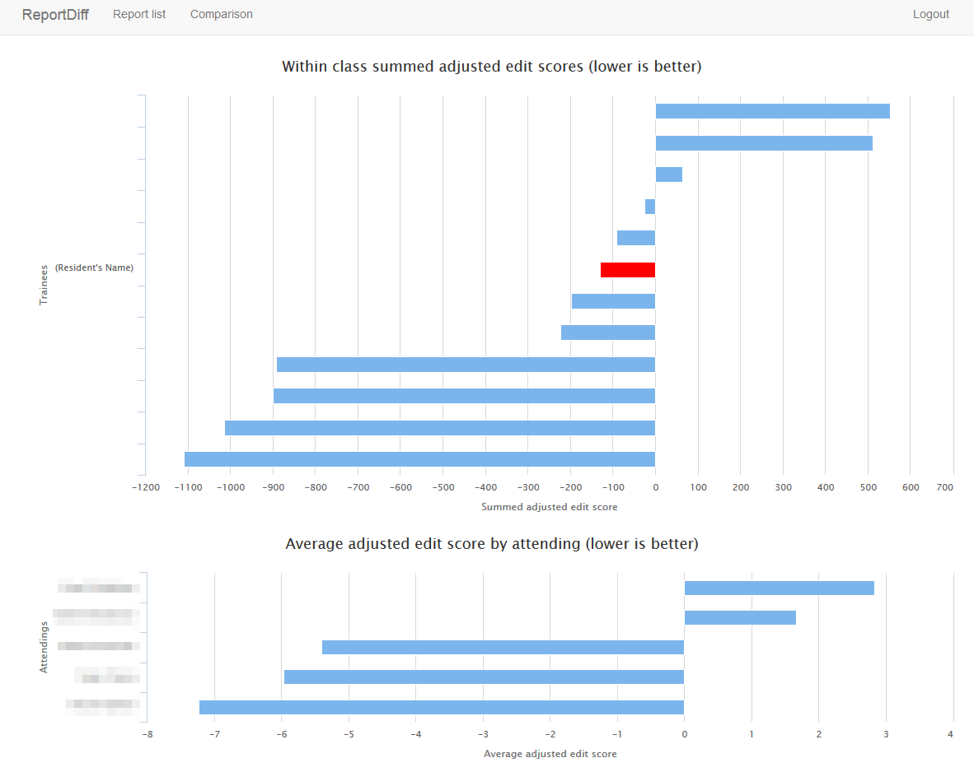
Trainees can view how their edit scores compare within their class,
as well as mean-adjusted average editing performed by attendings.

Slide 19
ReportDiff Analytics
Scripts using the R statistical environment and the open source ggplot plotting package can provide aggregate statistics and statistical plots of edit score data.
ReportDiff
Retriever
(Python)
ReportDiff
Server
(Python - Flask)
ReportDiff
Analytics
(R)

Slide 20
Report Analytics: Sample Questions
How do attendings and trainees compare to each other with respect to editing?
Heat map representations
How do trainee edit scores vary with training time?
Does trainee productivity (number of reports dictated) correlate with edit scores (report “accuracy”)?

Slide 21
Trainee comparison problems
Residents can be ranked by mean z-score
x_{ij}=average edit score for resident i with attending j
μ_{j}=average edit scores for all reports edited by attending j
σ_{j}=standard deviation for all reports edited by attending j
However, such rankings can be unstable if there are attendings who do little editing, i.e. when σ_{j} ≈ 0
$$z_{ij}=\frac{x_{ij}−μ_{j}}{σ_{j}}$$

Slide 22
Standardizing edit scores
We postulate that attendings with higher variability in report editing (reflected by $σ_{j}$) provide more discriminating and “meaningful” edits, which should carry more weight in ranking
As a result, we can rank by a simplified adjustment of the mean editing score:
$$z_{ij}=\frac{x_{ij}−μ_{j}}{σ_{j}}$$
$$z_{ij}^{′}=x_{ij}−μ_{j}$$
Simplified adjusted edit score “weighted” by $σ_{j}$

Slide 23
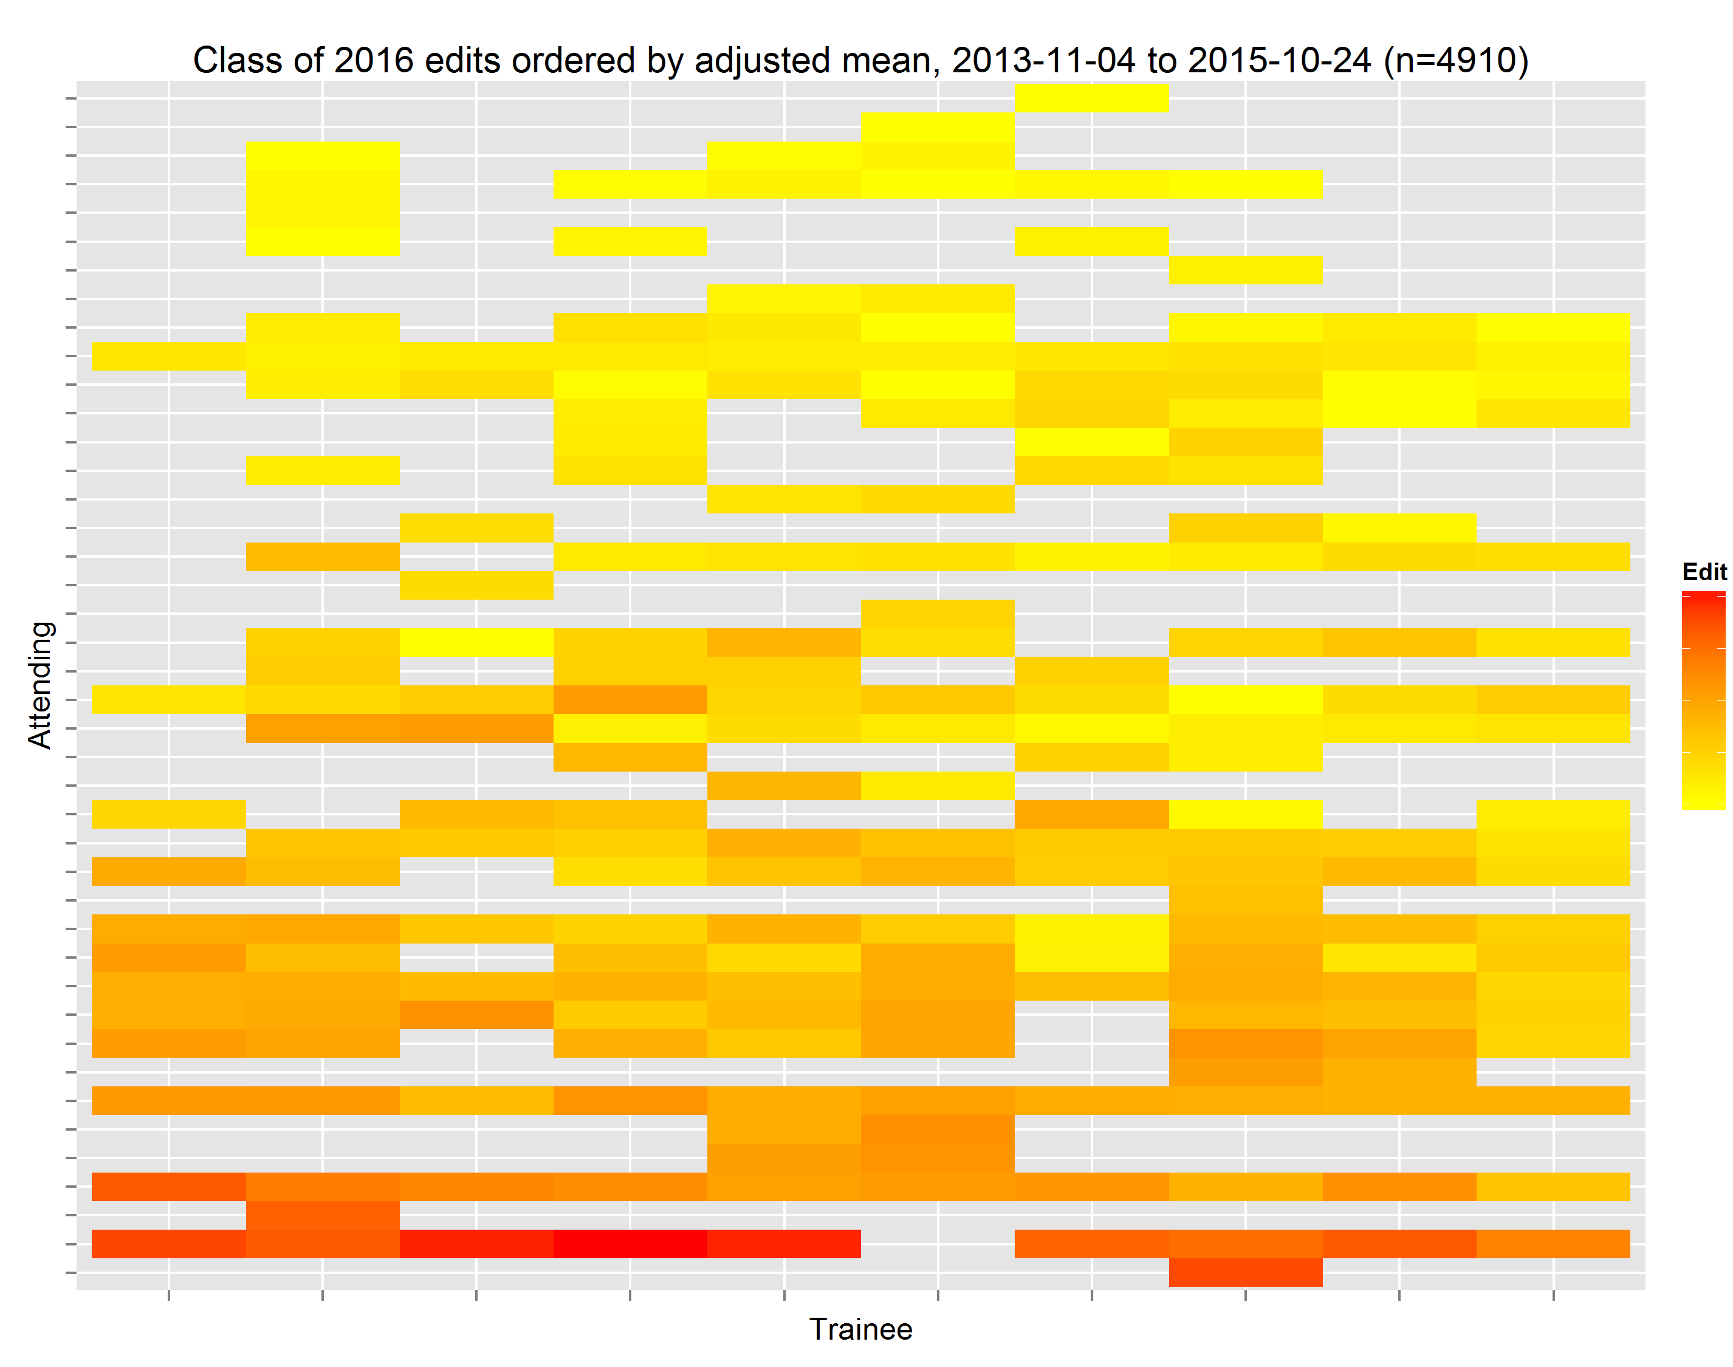
Heat map representations
Heat maps: graphical representations of matrix data where values are represented as colors
Can be used to rank residents and attendings by editing scores
Less Editing
More Editing
More Editing
Less Editing

Slide 24
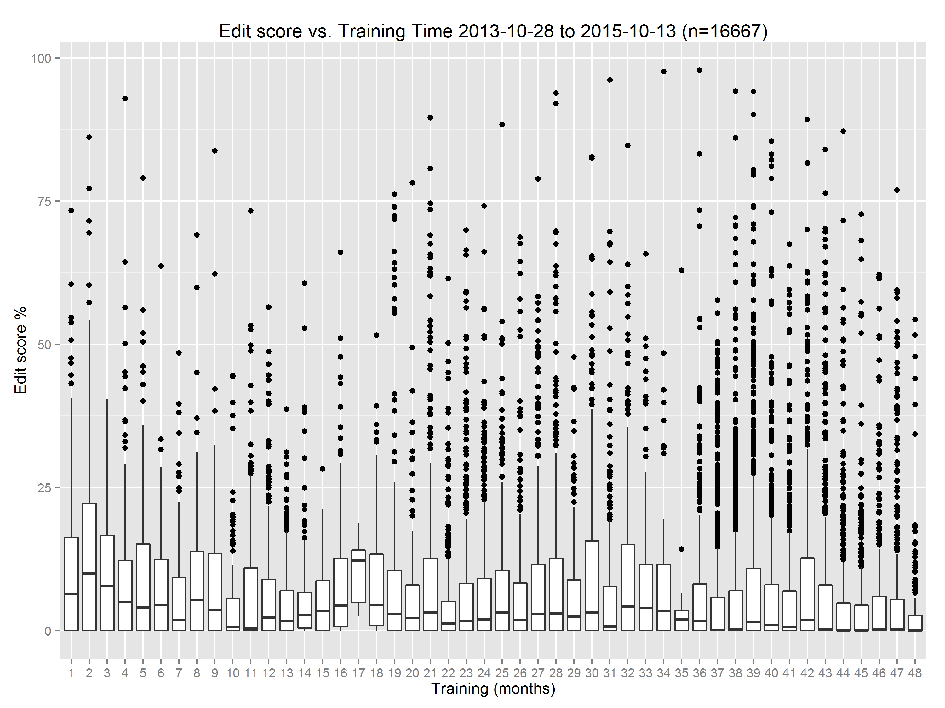
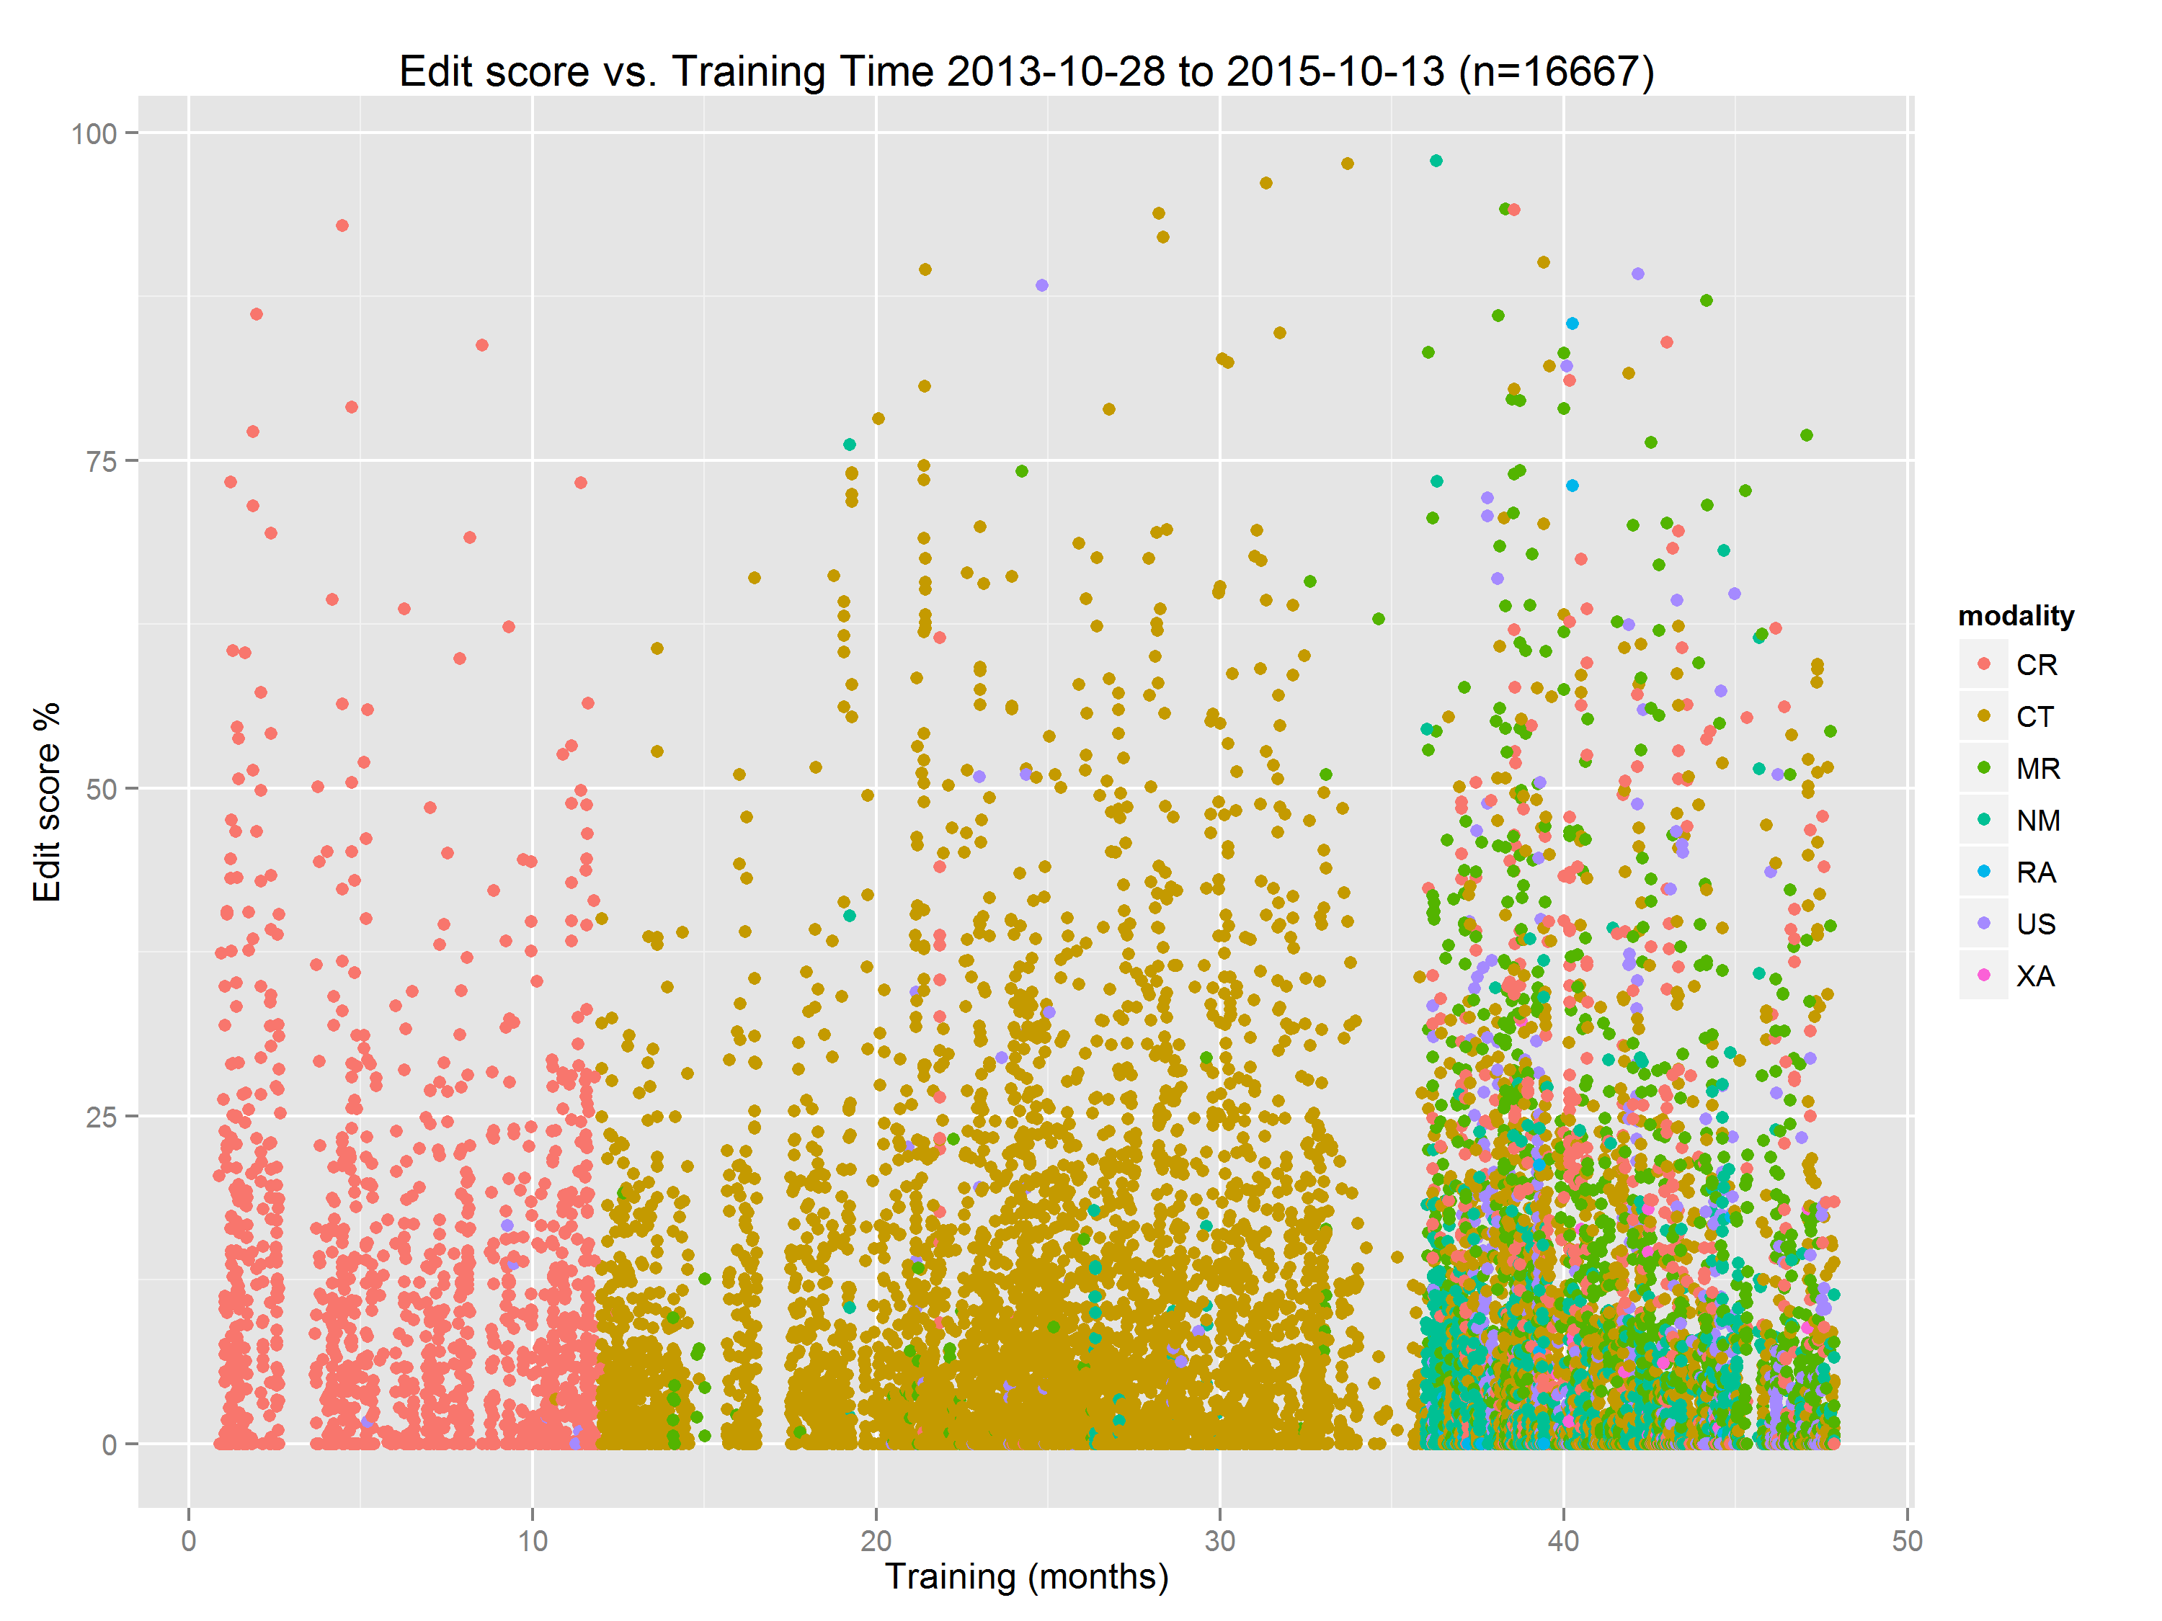
Edit scores and training time
At our institution, edit scores do not decrease with training time!
Possible explanations:
trainee reporting skills have not yet benefited from feedback
increased complexity of studies (reflected by modality distribution) read by more senior trainees

Slide 25
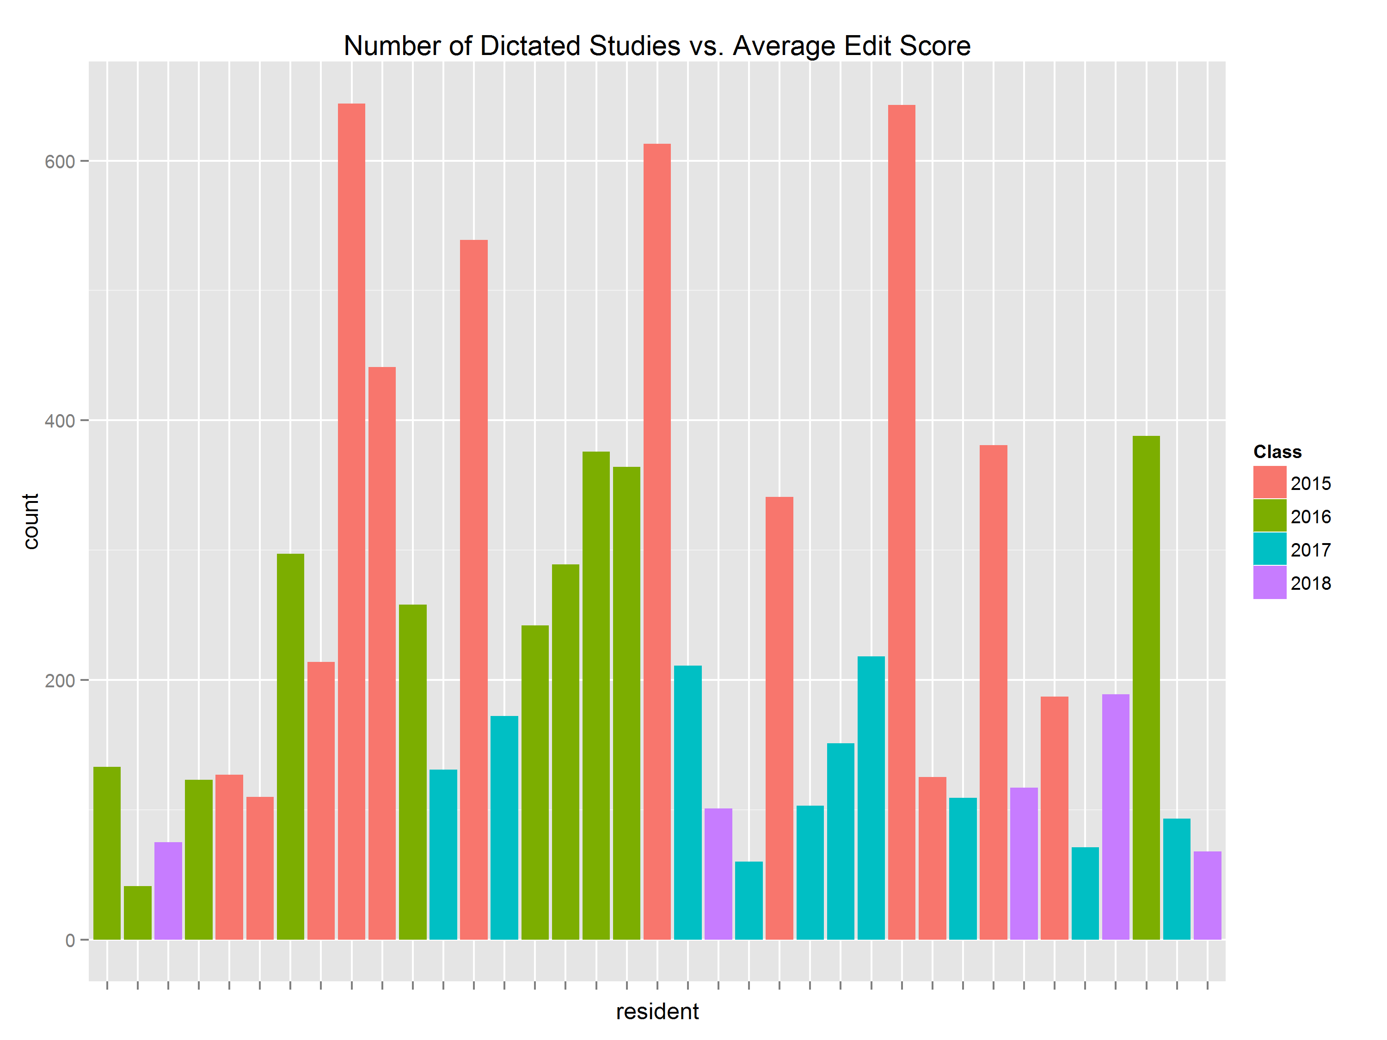
Accuracy and Productivity
No clear correlation seen between dictation productivity (given by number of dictated reports) and accuracy (given by edit scores)
Number of dictated studies
High edit %
Low edit %

Slide 26
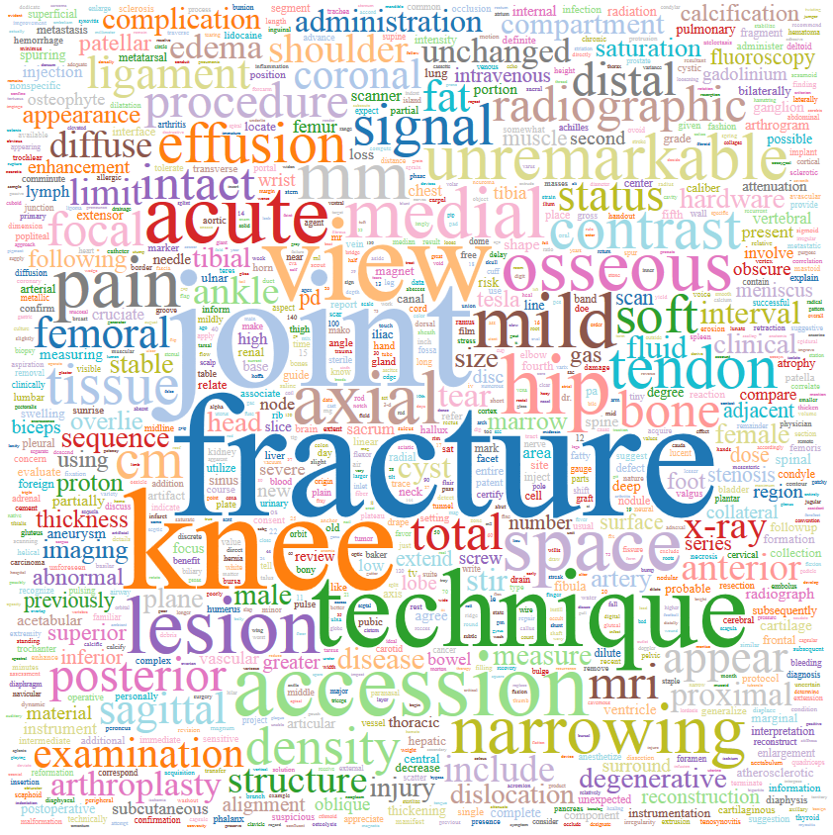
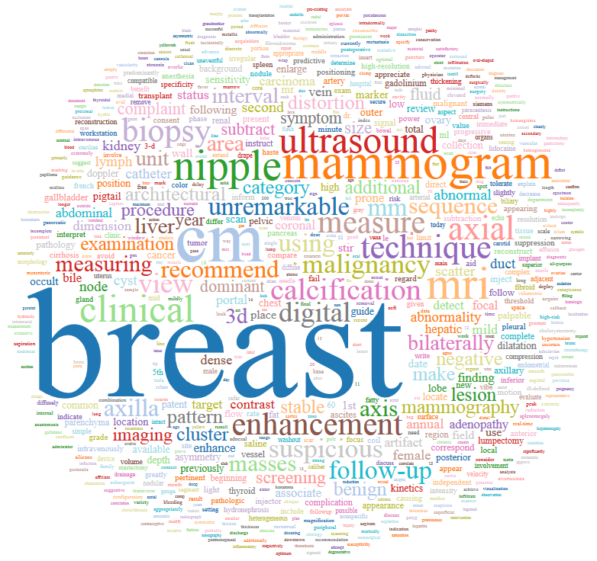
Vocabulary analysis
Analysis of disproportionately used words in trainee reports can give insight into trainee reporting habits and reviewed study types
Word cloud for musculoskeletal fellow
Word cloud for women’s imaging fellow

Slide 27
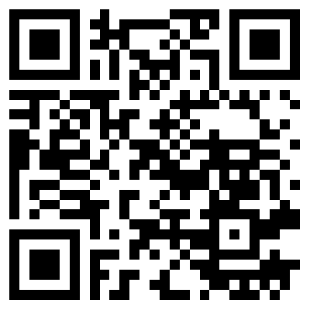
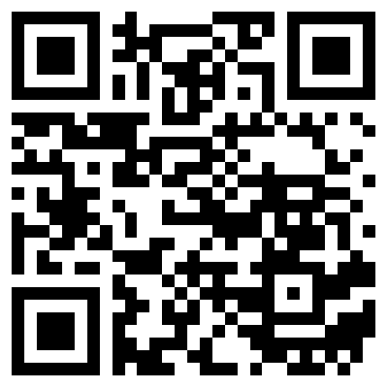
Source Code Availability
ReportDiff source code is available under the Apache 2.0 open source license.
https://github.com/pmcheng/reportdiff
(core scripts)
https://github.com/pmcheng/reportdiff_flask
(web server)

Slide 28
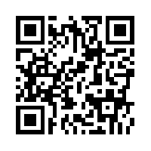
Summary
ReportDiff, an open source system, facilitates feedback and analysis for resident dictated preliminary reports.
More information:
http://hsc.usc.edu/~phillimc/reportdiff

Slide 29
References
Gorniak RJT, Flanders AE, Sharpe RE. Trainee Report Dashboard: Tool for Enhancing Feedback to Radiology Trainees about Their Reports. Radiographics 2013; 33: 2105-2113.
Surrey D, Sharpe RE, Gorniak RJT, Nazarian LN, Rao VM, Flanders AE. QRSE: a Novel Metric for the Evaluation of Trainee Radiologist Reporting Skills. J Digit Imaging 2013; 26: 678-682.
Sharpe RE, Surrey D, Gorniak RJT, Nazarian L, Rao VM, Flanders AE. Radiology Report Comparator: A Novel Method to Augment Resident Education. J Digit Imaging 2012; 25: 330-336.
Khandheria P et al. Developing a Clinically-Integrated Resident Worklist for Follow-up and Finalization Report Change Detection. SIIM Annual Meeting 2013.

